Slide 1
Predicting Neurological Outcome at Discharge in Patients with Traumatic Brain Injury
Health Informatics, Spring ‘21
Louis A. Gomez

Slide 2
Introduction
Traumatic Brain Injury (TBI) is a severe condition due to a sudden trauma such as a bump, blow or jolt to the brain which causes disruption of the normal brain functioning¹.
To measure the severity of TBI and neurological outcomes after discharge, the Glasgow Coma Scale (GCS) has been studied
1. A. Peterson, L. Xu, J. Daugherty, and M. Breiding, “Surveillance Report of Traumatic Brain Injury related Emergency Department Visits, Hospitalizations, and Deaths -United States 2014,” Center for Disease Control and Prevention, 2019.
Notes:
It affects a wide range of the US population and in 2014 2.87 million people were hospitalized or died due to TBU related incidents

Slide 3
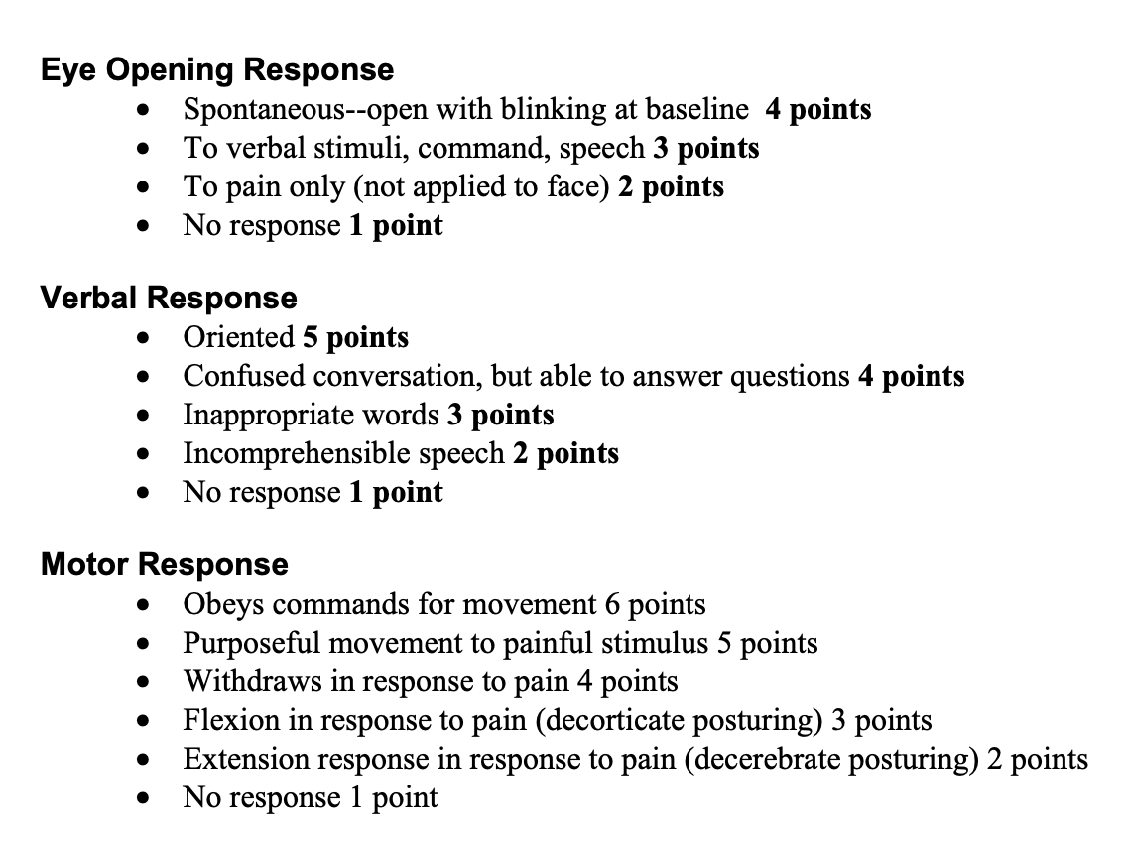
Introduction: Glasgow Coma Scale
The GCS is a behavioral assessment comprised of three scales: motor, verbal and eye response.
Motor subcomponents (mGCS) is a proxy for neurological function²
M. Balestreri et al., “Predictive value of Glasgow coma scale after brain trauma: change in trend over the past ten years,” p. 2.
Notes:
The GCS is a behavioral assessment designed to assess the depth, duration of coma, and impaired consciousness for patients in the ICU who have suffered from a brain injury
Prior work has shown that the total GCS can be misleading, and the motor response is closely aligned with neurological outcomes.
The development of an accurate tool can help doctors either intervene early or devote more clinical resources to patients.

Slide 4
Related Work
CRASH – Corticosteroid Randomization After Significant Head Injury
IMPACT – International Mission for Prognosis and Analysis of Clinical Trails in TBI
Notes:
CRASH is to predict 14 day, 6 month mortality and unfavorable outcomes – logistic regression models with pre-selected clinical features – extension including head CT and physio variables – auroc 0.82 and 0.79
Most work use the motor GCS as features
CRASH and IMPACT has variables that are specifically selected but we use a more data driven approaches looking at all the data that is available to us
But here we take a wider data driven approach looking at all variables and lab recorded
IMPACT

Slide 5
Research Question
Can patient data from the first two days in the ICU can be used to predict neurological outcome at discharge?

Slide 6
Datasets
For this class project, I used static, vital signs and lab test results data from all patients admitted to the ICU with an ICD9 coding of TBI
ICD9 Codes: 800,801,850,851,852,853,854
Inclusion Criteria: Patients with an ICD 9 coding of TBI
Exclusion Criteria:
(i) Age < 18 yrs, (ii) ICU stay duration < 48 hours, (iii) A motor GCS score is not recorded at discharge

Slide 7
Datasets: Glasgow Coma Scale
Scores | Categories | Labels per category
1 | No response | 23
2 | Extension response in pain | 6
3 | Flexion in response to pain | 8
4 | Withdraws in response to pain | 25
5 | Purposeful movement to localized pain | 51
6 | Obeys commands | 339
Based on exclusion criteria, we have 452 unique ICU admissions for TBI with mGCS at discharge
Large data imbalance – (score of 6 has 75% of labels)

Slide 8
Methodology: Data Processing
To process data, I followed the standardized approach implemented in MIMIC Extract³
Clinical Groupings → Unit Conversions → Data Filtering → Data Aggregation
S. Wang, M. B. A. McDermott, G. Chauhan, M. C. Hughes, T. Naumann, and M. Ghassemi,
“MIMIC-Extract: A Data Extraction, Preprocessing, and Representation Pipeline for MIMIC-III,”
Proc. ACM Conf. Health Inference Learn., pp. 222–235, Apr. 2020,

Slide 9
Clinical Groupings → Unit Conversions → Data Filtering → Data Aggregation
This involves combining the itemids that represent the same information at a high level.
226707
211
Carevue
Heart Rate
226730
Height
220045
Metavision
1394
Notes:
This step is vital for two reasons. First, itemids for the same variable could be different in carevue and metavision. For example, heart rate has an itemid of 211 in carevue but an itemid of 220045 in metavision. Secondly, variables could have different itemids even in the same database source. For example, height has itemid 226707 and 226730 in metavision).

Slide 10
Clinical Groupings → Unit Conversions → Data Filtering → Data Aggregation
This involves converting similar itemids (defined in the previous step) to the same units.
Weight (kg, lbs., oz) → kilograms
Height (inches, cm) → Centimeters
Temperature (Celsius, Fahrenheit) → Celsius
226707
226730
Height
1394
Centimeters
Inches

Slide 11
Clinical Groupings → Unit Conversions → Data Filtering → Data Aggregation
This process used recommended variable ranges and filters them.
For variable values higher (or lower) than the valid range were imputed using previous values
For variables values beyond the valid ranges (i.e outliers) were replaced with nans

Slide 12
Clinical Groupings → Unit Conversions → Data Filtering → Data Aggregation
I computed the average of all variables values over the two days of data for all admissions

Slide 13
Bar chart showing the percentage of data measured in each clinical grouping
Notes:
At this stage, about 34% of the data is still missing as some clinically aggregated variables are not commonly recorded across patients. We fixed a threshold of 50% and dropped all features that did not meet the criteria. This step reduced the number of variables from 59 to 40 variables
We then normalize each variable to have a mean of 0 and a standard deviation of 1. The imputation and normalization were performed on the training set and then applied to the test set.

Slide 14
Methodology: Data Processing
Dropped all features who had data for less than 50% of patients. 59 -> 40 features
Mean Imputation and normalization
Notes:
At this stage, about 34% of the data is still missing as some clinically aggregated variables are not commonly recorded across patients. We fixed a threshold of 50% and dropped all features that did not meet the criteria. This step reduced the number of variables from 59 to 40 variables
We then normalize each variable to have a mean of 0 and a standard deviation of 1. The imputation and normalization were performed on the training set and then applied to the test set

Slide 15
Classification: Tasks
Classification tasks
Binary Classification Task
Non-command following (1,2,3,4,5) vs Command following (6)
339 sample in command following compared to 113 in non-command following
Notes:
This is the largest classification group and provides information about which patient will attain command following at discharge. The second task is a multiclass classification between all groups i.e. A/B/C/D. This task examines how predictive our classifier can be at distinguishing individual classes.

Slide 16
Classification: models
Classification Models:
Logistic Regression (LR), Random Forest (RF), Extreme Gradient Boosted Trees (XGBoost)
Training:
Split dataset into a 70/30 stratified split. Due to imbalanced dataset, added higher class weights to minority class. Default model parameters
Notes:
In XGBoost the weight is the ratio of the number of samples in the majority class to the minority class.
In logistic regression and random forest, we used the ‘balanced’ option that readjusts the weight inversely proportional to the class frequencies

Slide 17
Classification: Evaluations
Binary task
I report Precision, recall and F1-score.
Feature importance for each model.
Notes:
This is the largest classification group and provides information about which patient will attain command following at discharge. The second task is a multiclass classification between all groups i.e. A/B/C/D. This task examines how predictive our classifier can be at distinguishing individual classes.
Also examine which features across all both models are deemed important for classification

Slide 18
Results
Classification Models | Evaluation Metrics
 | Avg. Recall | Avg. Precision | Macro F1-Score
Logistic Regression | 0.69 | 0.65 | 0.66
Random Forest | 0.56 | 0.70 | 0.55
XGBoost | 0.67 | 0.66 | 0.66

Slide 19
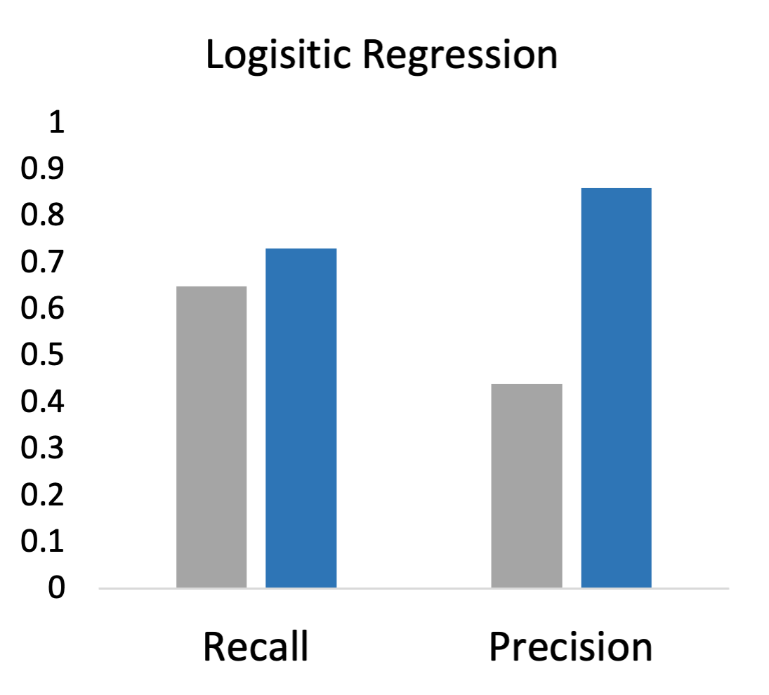
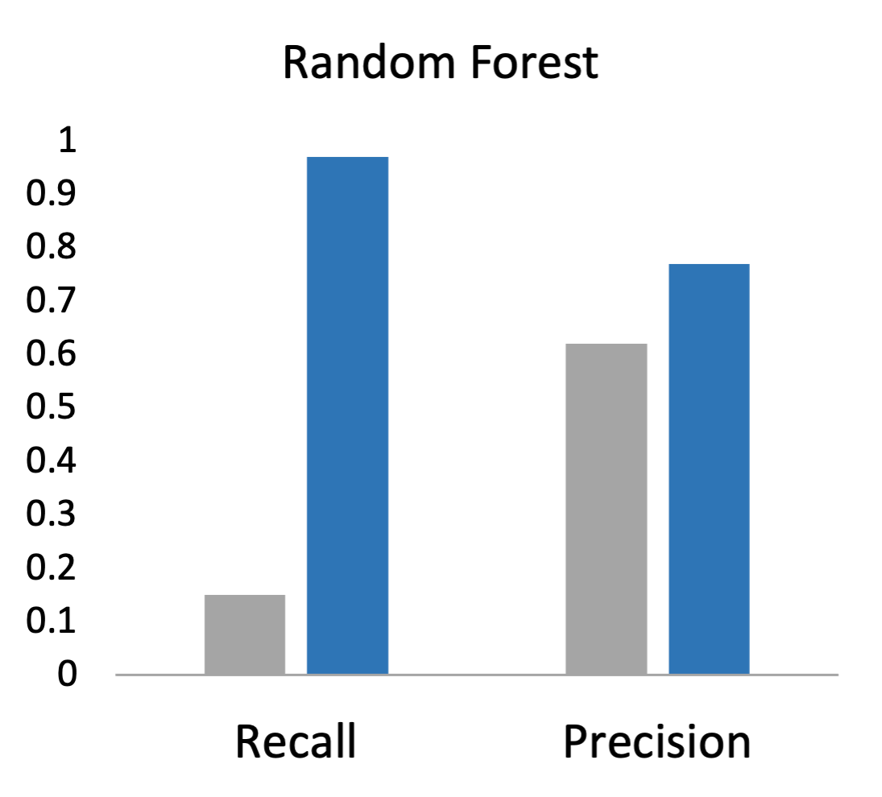
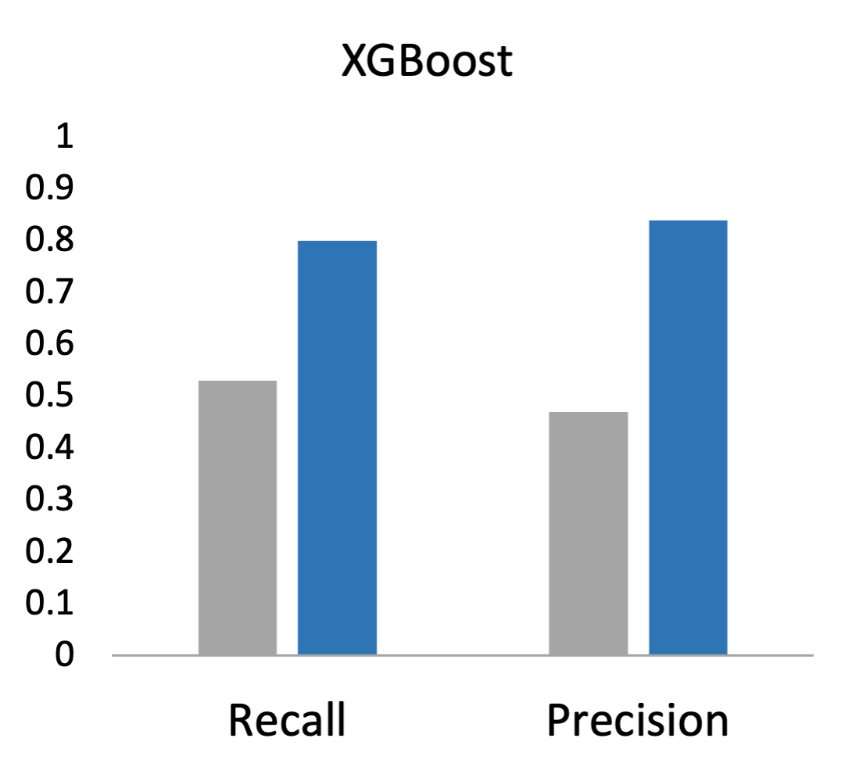
Results
Non-Command Following
Command Following

Slide 20
Results: Feature Importance (top 20)
Seven features in common across all models:
pH, white blood cell count, magnesium, partial pressure of carbon dioxide, oxygen saturation, plateau pressure, and hemoglobin

Slide 21
Limitations
Naïve simple mean imputation – future work could study impact of imputation of predictive performance
Small cohort of only 452 admissions – larger dataset is needed to learn a more general model
Imbalanced data approaches – other techniques to either oversample minority or under-sample majority classes
Future work could include other data modalities – clinical notes, drugs, and waveform data

Slide 22
Questions?

